Slide 2
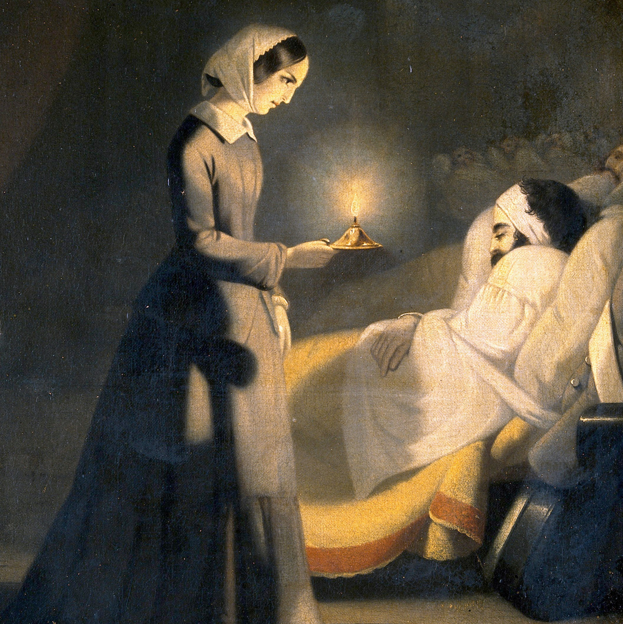
Design your own hospital
Florence Nightingale

Slide 3
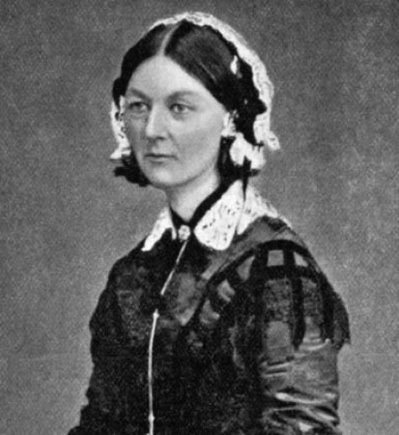
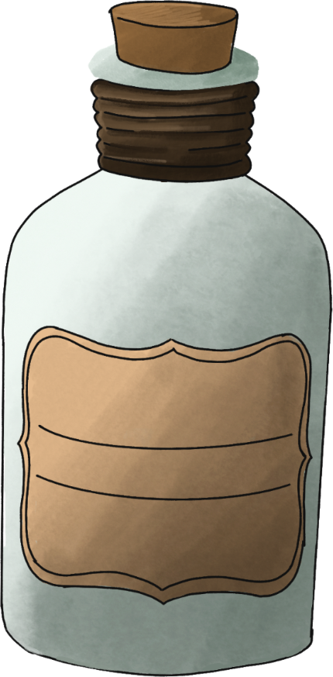
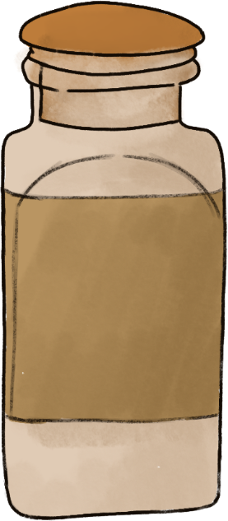
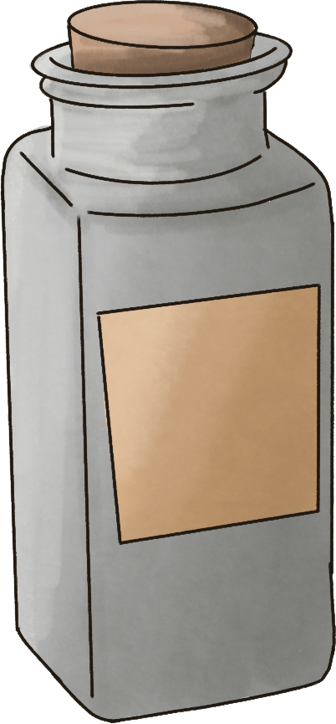
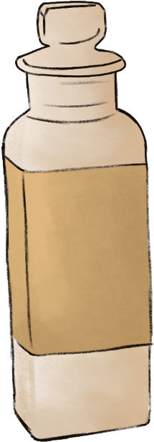
Florence nightingale

Slide 4
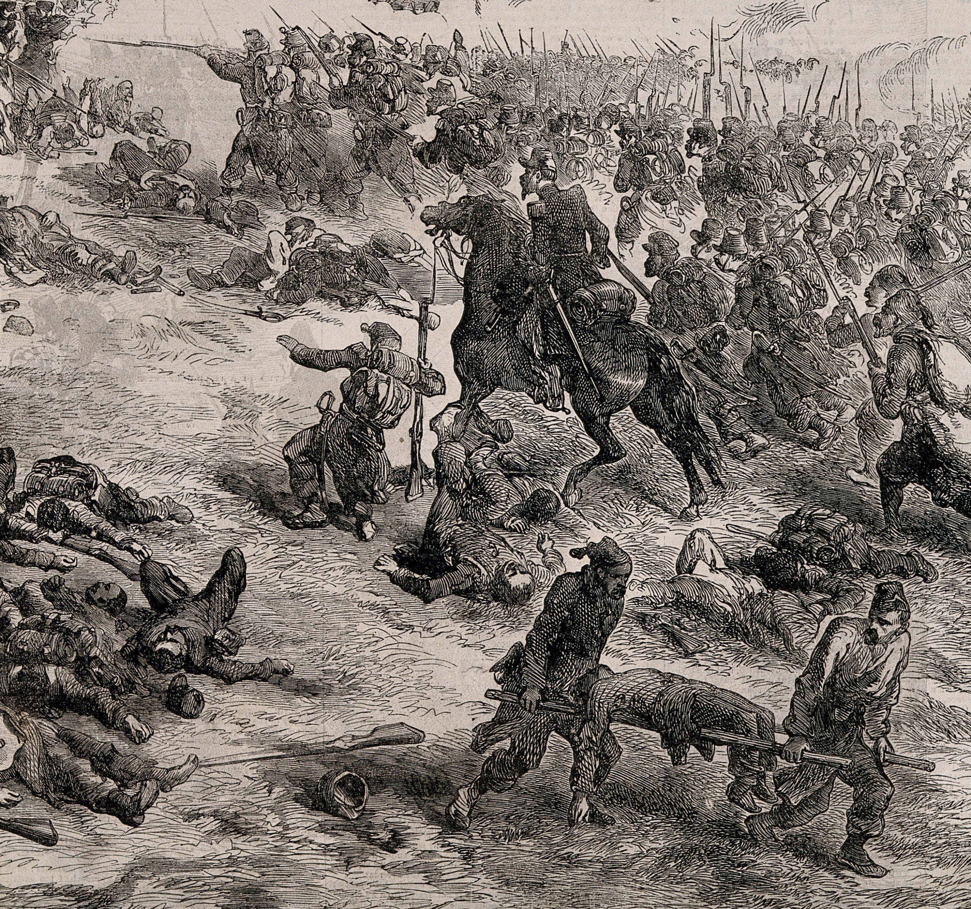
Florence Nightingale
was famous for being a nurse,
but did you know she also helped design hospitals?

Slide 5
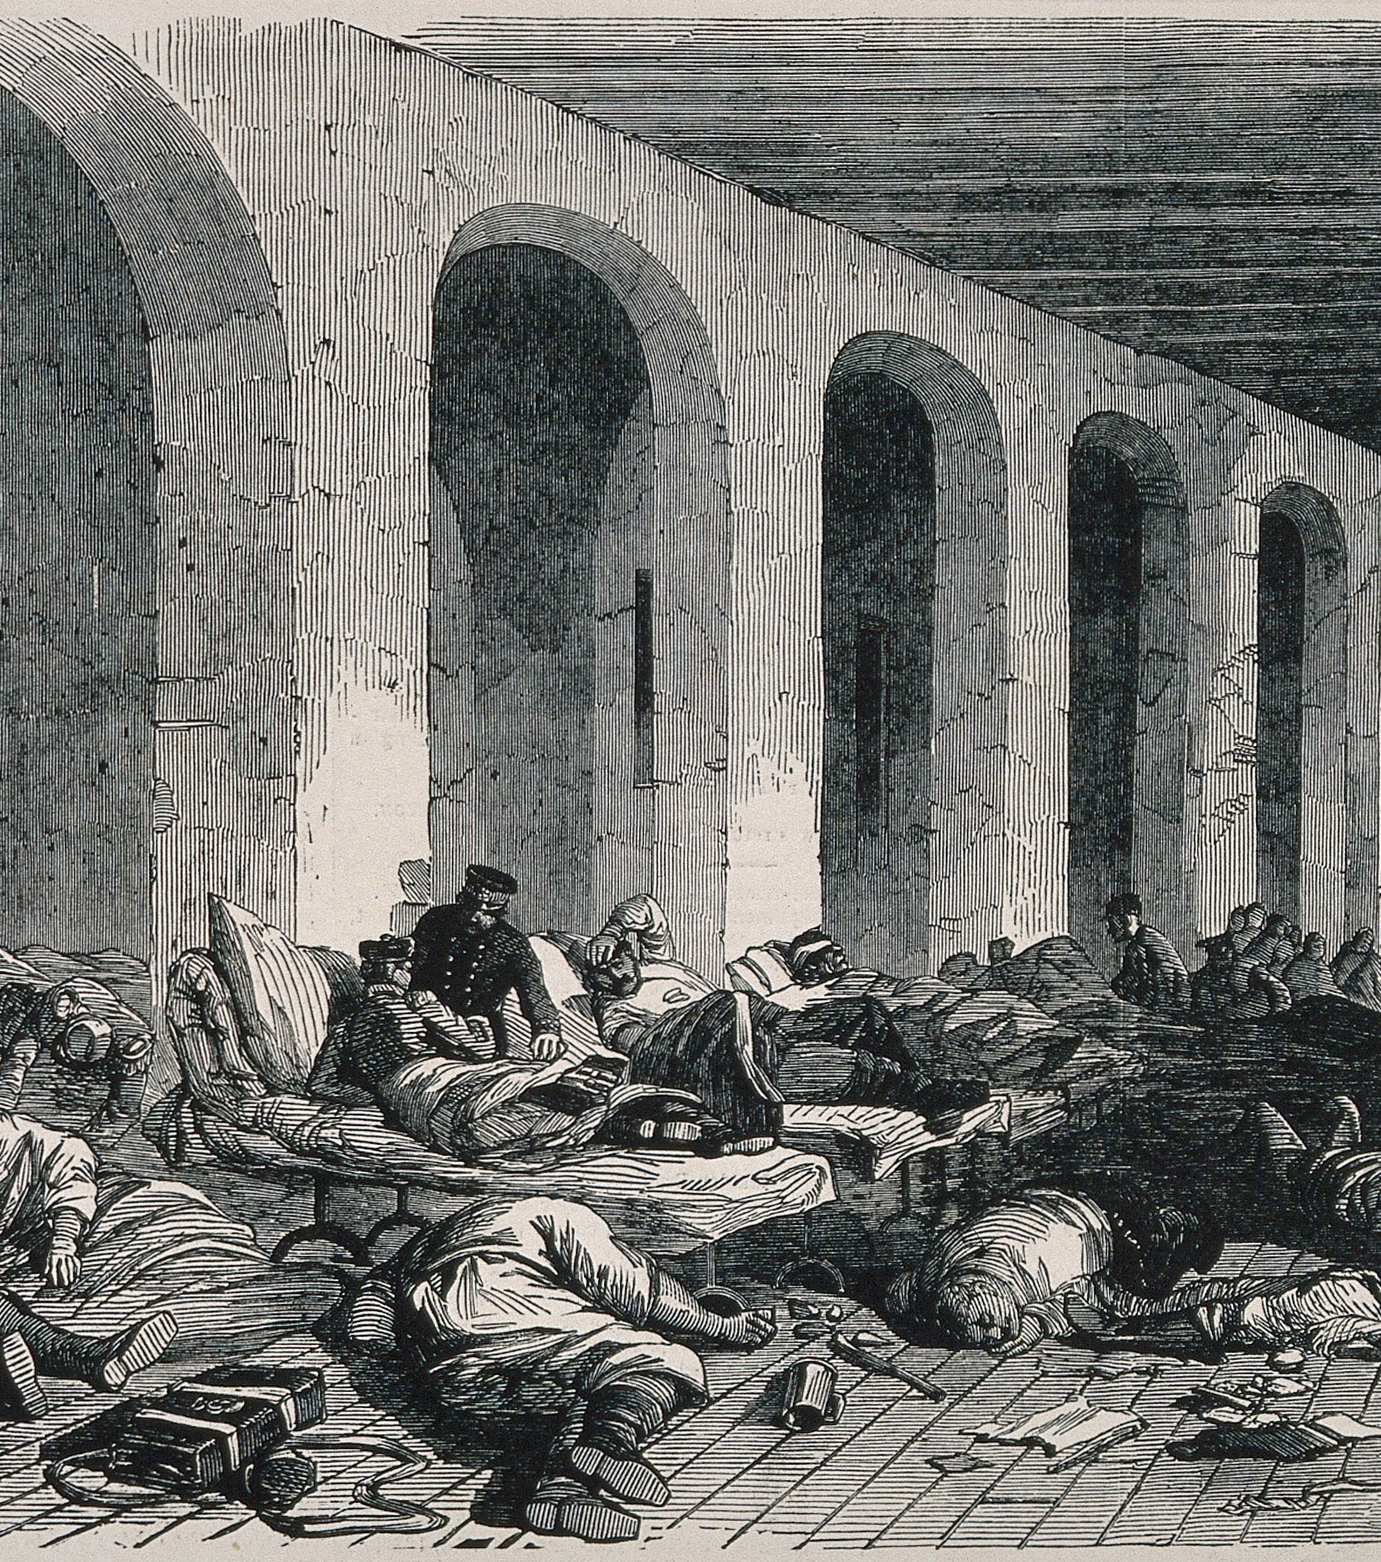
Florence took 37 nurses to help care for the soldiers in the Crimean War.
She travelled to a place called Scutari in Turkey, where there was a hospital.
When she arrived, she discovered that more soldiers were dying of diseases than from their wounds.

Slide 6
There were no nurses when she arrived, and no-one was looking after the patients properly.
There weren’t enough beds, so patients were lying on the floor,
There were rats and flies everywhere,
The doctors didn’t even wash their hands,
The food was awful,
And there was a dead horse in the well!

Slide 7
Why do you think the wounded soldiers got sick from being in the hospital?

Slide 8
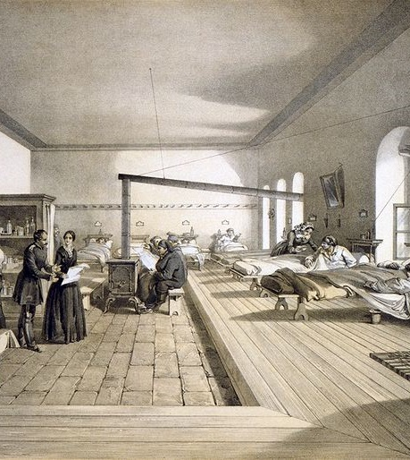
Florence made lots of changes to the hospital at Scutari, and the soldiers started to get better.
After the war, she helped design hospitals in Britain.

Slide 9
Florence kept records and drew graphs to show doctors and the government that people were getting sick and dying because the hospital was so bad.
Why are people dying in our hospital?
She wanted to make changes to help people get better, and she had lots of ideas about how to do that.

Slide 10
Can you guess what Florence said would help sick people get better?
Fresh air
Baths and toilets
Sunlight
Clean clothes and bedding
Healthy food
Warmth
Clean water
Quiet
Nurses to look after them!
Why do you think these things are important?

Slide 11
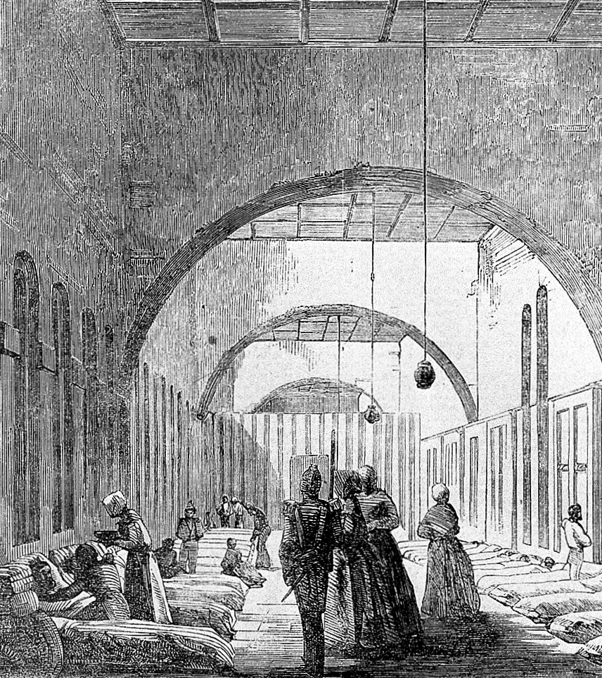
Florence also said that patients with different diseases should be in separate wards, so that their diseases wouldn’t spread to other patients.
And she made the doctors wash their hands!

Slide 12
Design your hospital

Slide 13
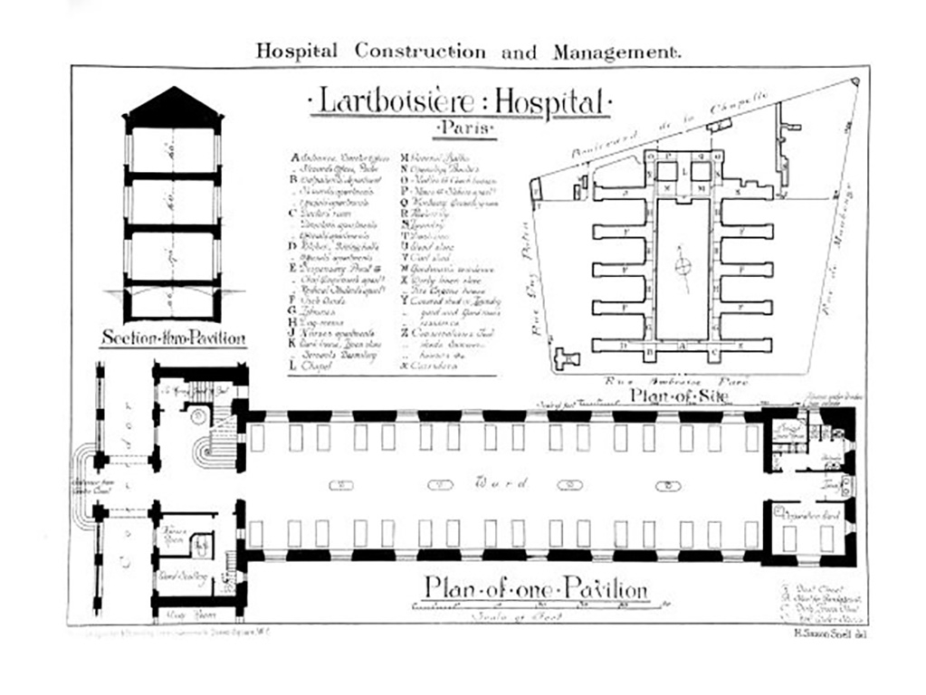
You are going to design your own hospital.
Each person or group can design a different part of the hospital.
Choose what part of the hospital you are going to design.
Draw your room design on a big piece of paper.

Slide 14
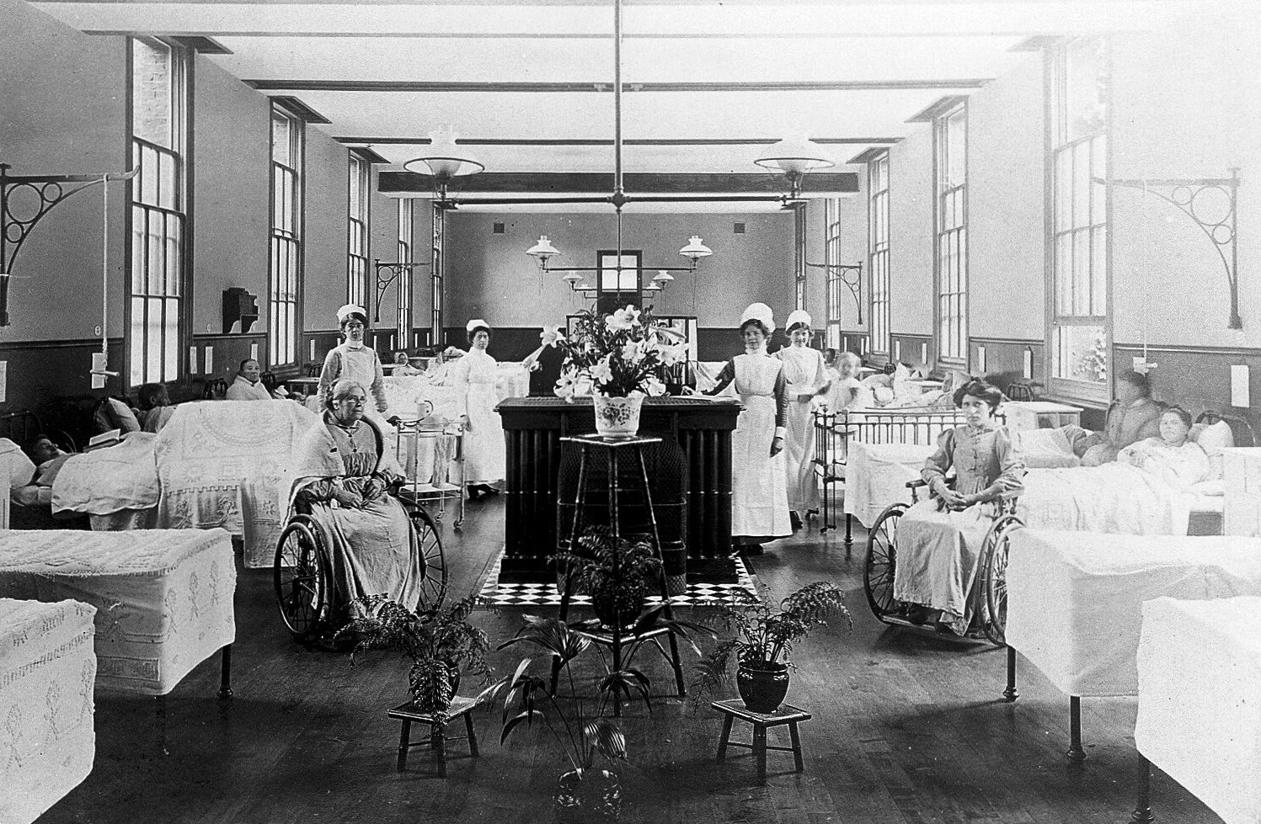
What rooms will your hospital need?
You could include:
Different wards
Think about things like:
Operating theatres
Somewhere to sleep
A laundry
Somewhere to eat
A kitchen
Somewhere to wash
Bathrooms and toilets
Storage
Rubbish bins
What will you need in each room?

Slide 15
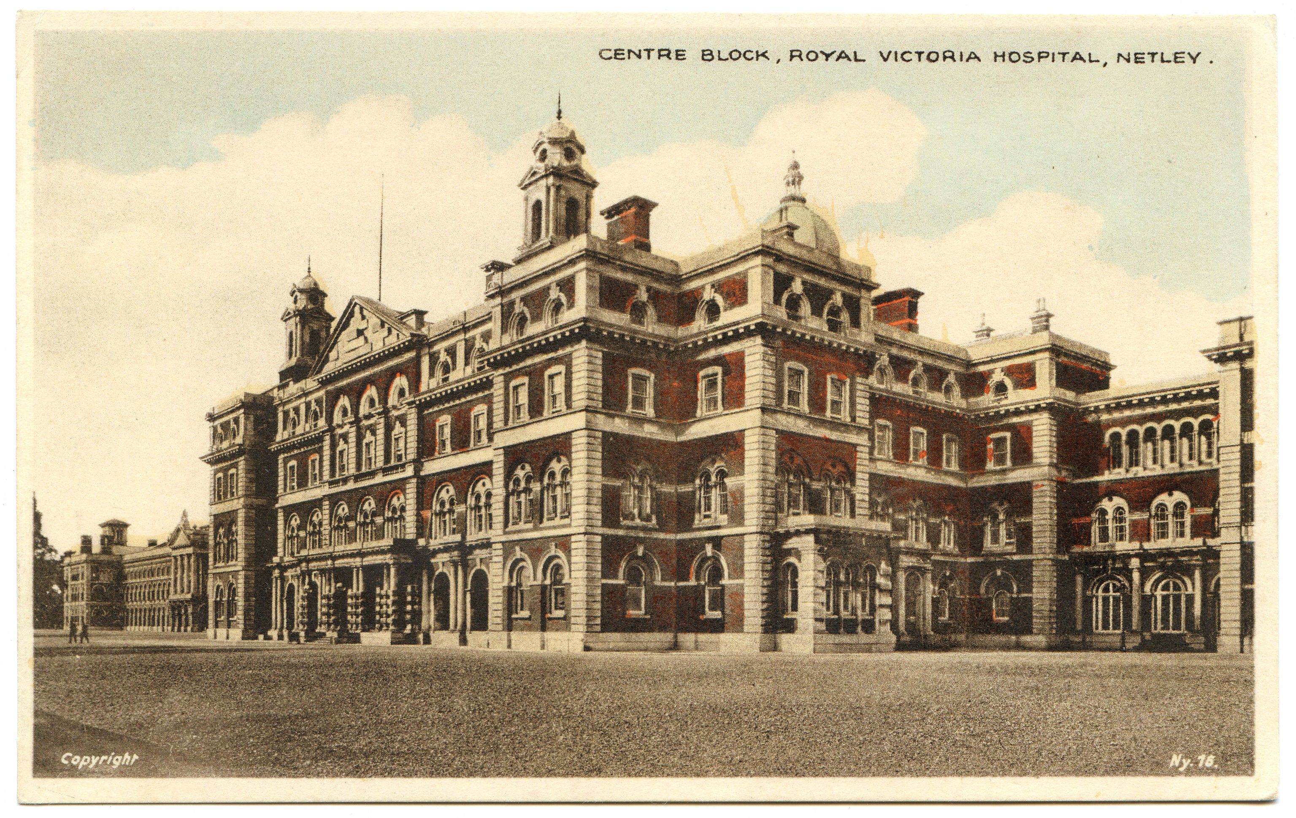
When you are finished, you can tell everyone about your room.
Then put them all together and make your hospital.
Don’t forget to give your hospital a name!

Slide 16
Design your own hospital
Florence Nightingale
© Marvellous History 2024
All rights reserved
All photographic images used under licence from Freepik or Creative Commons – details on request.
Graphics used under licence from Freepik.com
All other content © Marvellous History Ltd

